Slide 1
Go Safe
Hop, Dodge, Survive!

Slide 2







Content
Core Gameplay Mechanics
Level Structure & Difficulty
UI, Controls, & Audio
Dodging vehicles and drones.
Hop, dodge, and survive!
Navigating hazardous roads and rivers.
Technical Overview & Production
Audio Presentation
Live Gameplay Demonstration
Technical details
Visual and sound design
See the game in action.
References
Reference links
Notes:
References Links to external resources

Slide 3
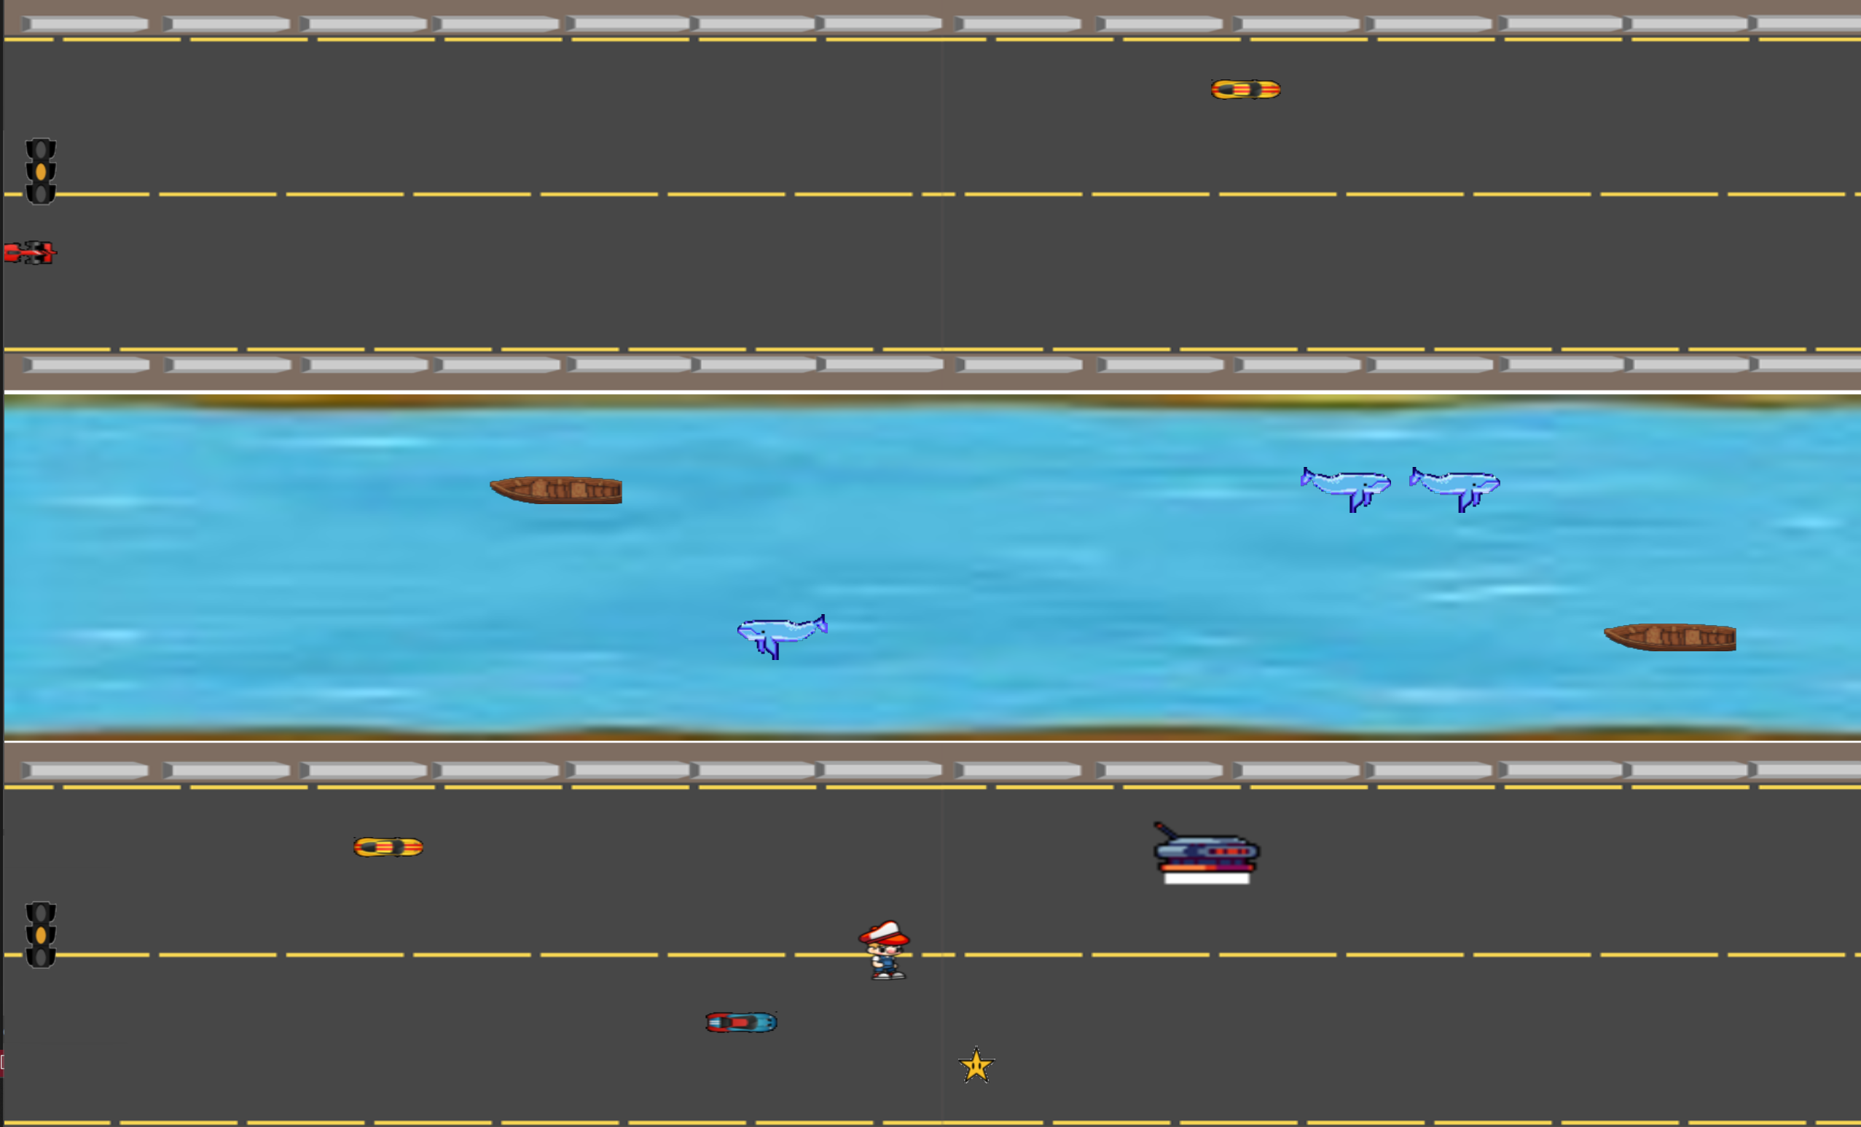
Core Gameplay Mechanics
1
Movement
Use keyboard (W, A, S, D) and Space for jumping.
2
Traffic Signals
Automated cycle (Green: 3 s, Yellow: 2 s, Red: 2 s) that affect vehicle speed.
3
Safe River Mechanic
Activate a sliding animation via power-up to cross rivers safely.
4
Enemy Behavior
Vehicles adjust speed globally based on signal state. Drones follow the player with an offset and use lasers.

Slide 4
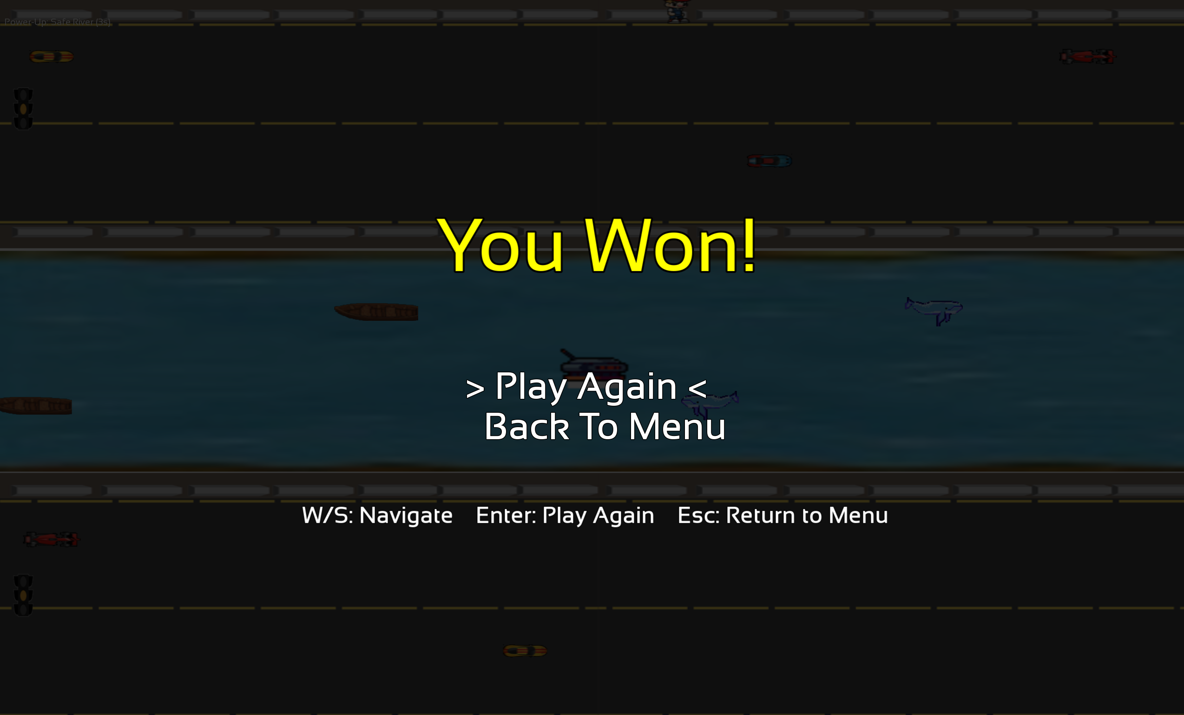
Level Structure & Difficulty
Level 1
Fewer obstacles, slower traffic, a gentle introduction.
Level 2
Increased enemy spawn rates, faster vehicles, heightened challenge.

Slide 5
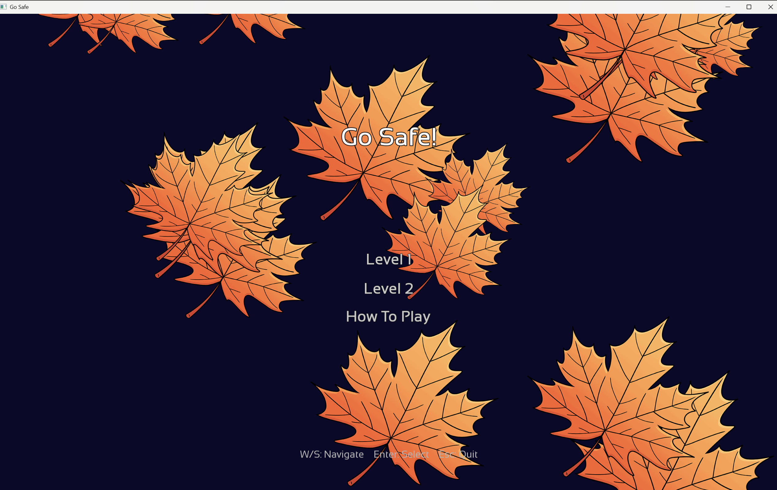



UI, Controls, & Audio
Menus
Clean, modern UI with falling leaves background animations.
Controls
Responsive keyboard controls with W, A, S, D, Space for jump, ESC to return to the menu, etc.
Audio
Continuous background music on a dedicated channel. Responsive one-shot sound effects (jump, run, collision).

Slide 6




Technical Overview & Production
Development
1
Developed in C++ using SFML, optimized for PC.
Assets
2
Uses texture atlas (gosafe.png) for art assets.
Audio
3
Distinct systems for background music (sf::Music) and sound effects (via MusicPlayer or dedicated SoundPlayer).
Gameplay
4
Robust procedural generation for level elements and dynamic hazard spawning.

Slide 7
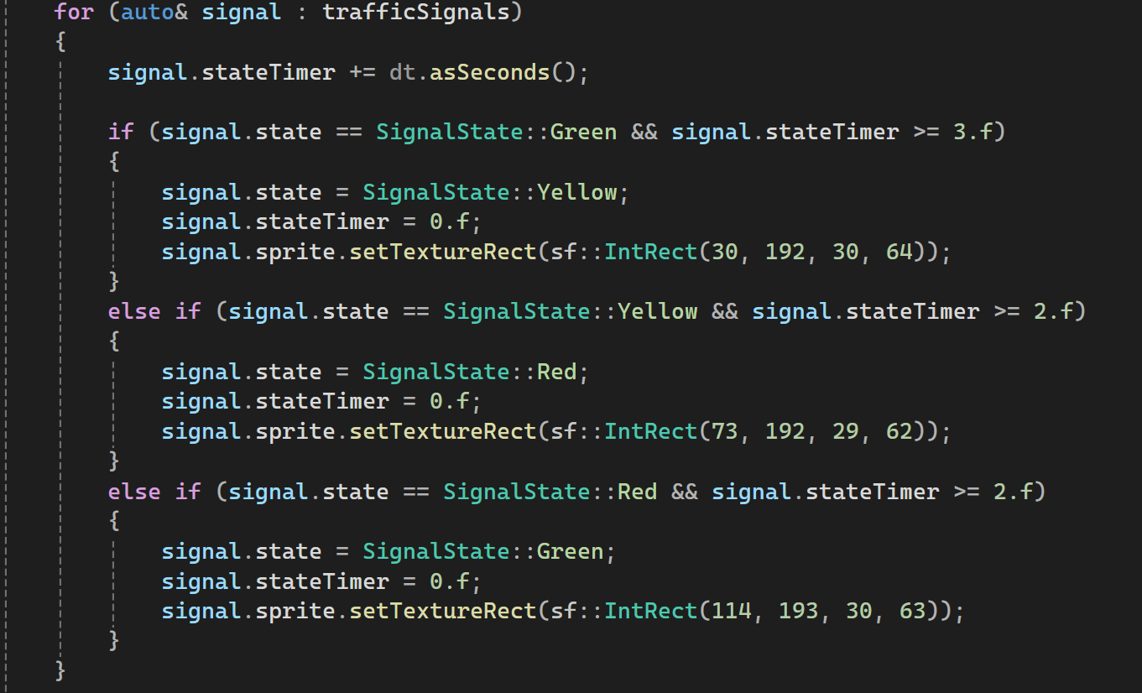
Code Extract: Automated Traffic Signal

Slide 8

Audio Presentation
Music: Go Safe
Sound Effect: Run
Sound Effect: Jump

Slide 9
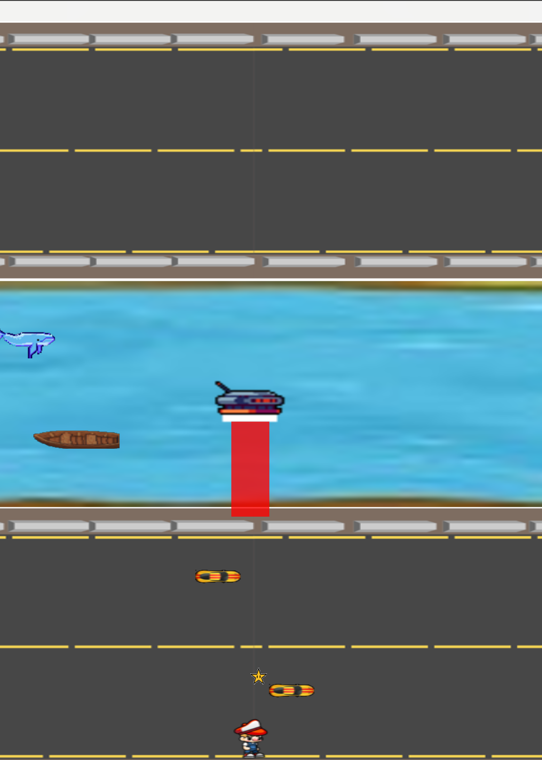
Live Gameplay Demonstration
Level 1
Fewer obstacles, slower traffic, a gentle introduction.
Level 2
Increased enemy spawn rates, faster vehicles, heightened challenge.
Gameplay Mechanics
Automated traffic signals affecting vehicle speed. Safe river sliding, collision, and drone behavior.

Slide 10
References
SFML Documentation: https://www.sfml-dev.org/documentation/2.5.1/
Game Programming Patterns by Robert Nystrom: https://gameprogrammingpatterns.com/
For sound effects: https://pixabay.com/
Sprites: https://itch.io/

